Slide 1
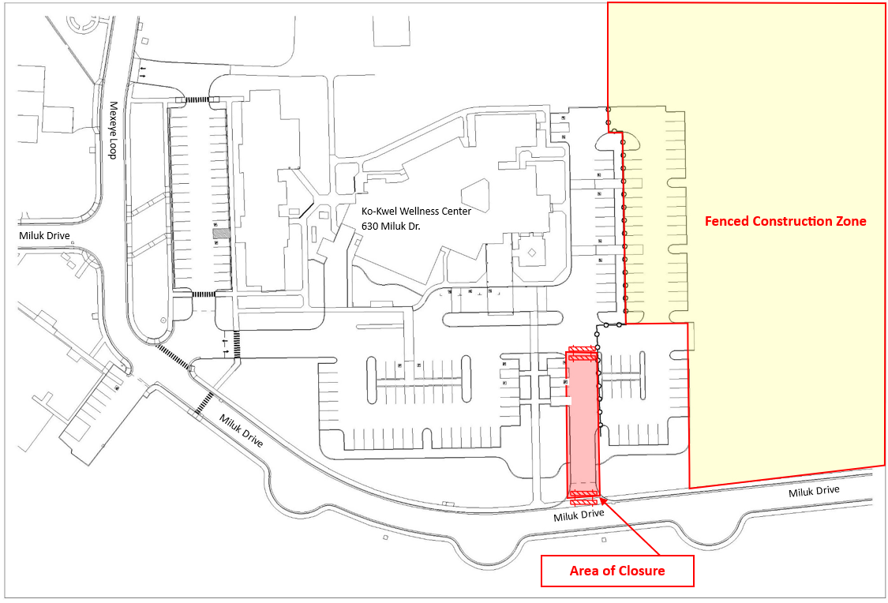
Shishda Haws
Changes to Upcoming Impacts • April 19, 2024
Ko-Kwel Wellness Center Main Parking Lot Entrance Closure
Previously announced, the Ko-Kwel Wellness Center secondary parking lot entrance will be closed (as outlined above) to install water and sewer utility lines. Dates have shifted once again, this time to consolidate impacts to one week.
The entrance will now be closed beginning Monday, April 29th and reopen on Wednesday, May 1st (previously reported to be Wednesday, April 24th through Friday, April 26th). The asphalt will be cut, the trench excavated, the pipe installed. The trench will then be filled, recompacted, and covered with a temporary trench-plate (those big metal plates you sometimes see in road construction) in place until an asphalt patch can be completed. Please use an alternate entrance during this time and always, please use caution near the construction area.
Project Management & Planning Office • (541) 297-1355 • projects@coquilletribe.org

Slide 2
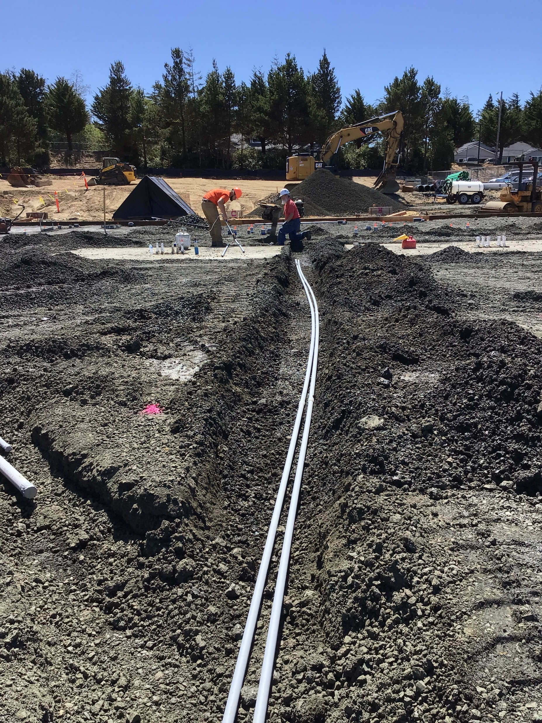
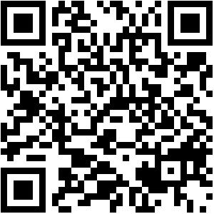
Foundation Pour - Early Morning Work Hours
The contractor is getting ready to pour the foundation. Footings for the main columns in the new building will be poured this week. The foundation slab will be poured at the end of the month in three separate pours the week of April 29th.
To get this work completed in the time needed, work must begin in the early morning hours. Crews will begin their concrete pours at 5am on Monday, April 29th, Wednesday, May 1st, and Friday, May 3rd. The concrete trucks will use the main Ko-Kwel Wellness Center entrance to enter/exit the site as the Secondary entrance will be closed. The trucks will be backing into the site for these pours and back-up alarms
will be heard as well as the noise of the trucks themselves. The site will be lit with work lights directed towards the Ko-Kwel Wellness Center to avoid lighting neighboring residences. Crews will do their best to keep noise and disruptions to as little as possible.
We recognize that these disruptions are uncomfortable and appreciate your patience and flexibility during these impacts.
Learn more
Project Management & Planning Office • (541) 297-1355 • projects@coquilletribe.org

